Slide 1

Health Insurance Risk Proliferation
Get rewarded for doing something good to yourself
2021 to lifetime

Slide 2
If you have already seen the earlier installment of this presentation
You could skip to slide number – 3,8,9,11,13,14,15,16 as they have new content.

Slide 3
Problem statement that we intend to solve
Health conditions of Indians is particularly poor. We intend to motivate people to live a healthy lifestyle and get themselves an insurance.
Currently, health infrastructure and insurance sector is poorly performing.
People don’t get motivated enough to get an insurance.
HEALTH

Slide 4
Our approach to solve
As of now Insurance Companies decide Customer's Health Insurance Payment based on age, pre-existing disease, initial body tests which can lead to more rate of reimbursement which is financially not good.
We will take real-time data regarding health and reward the customers with perfect discounts in premium for that quarter.
Real-time data will be gathered through smart wearables and mobile apps.
We work to insure but our priority is your health and well-being.

Slide 5

Insurance
Health insurance is one of the most important target to achieve in current times.
You as an individual can contribute to your family even when you are in hospital or dead.
We as a company stand out to motivate you to develop a healthy lifestyle and also insure your family.

Slide 6

People lack motivation
Healthy lifestyle can actually be rewarding monetarily
Get yourself insured with a particular policy.
Insurance premium is the most flexible part in this product.
Prove your fitness and health and get reduced money to pay.
Particularly in India, money is always a big factor and this product as a company will be best in class due to its variable pay and reap scheme.

Slide 7

Features
Your act decide your premium for each quarter.
The company gives you premium for a particular health index. If you perform and maintain the health better than a particular index, there is a decrement in premium and if you deteriorate then there is a increase in premium.
Simply, manage your health and get rewarded.

Slide 8
How will inputs be taken?
Heart points will be taken input from a mobile app. Smart wearable will take inputs of calorie intake, calorie burnt, sleep time, blood pressure and cholesterol. User will provide data of height, weight and heart ailments.

Slide 9
Health index
We define health index on a scale of 100, in which 100 is the best score and level of fitness you can achieve.
Health index is based on different weighing of different components mentioned in following slide.

Slide 10
Health Index
Your health score is more important than your credit score
Ideal scores | Age 18-30 | Age 30-45 | Age 45-60
Body Mass Index [BMI] | Ideal = 23 | Ideal = 23 | Ideal = 22
Calorie burnt per day | 600 | 550 | 450
Calorie intake per day | 2000 | 2000 | 1700
Sleep hours | 7 | 7.5 | 8
Heart points | 200 | 170 | 150
Net calorie difference | 1500 | 1400 | 1250
Blood Pressure | If found = -1 | If found = -1 | If found = -2
Cholesterol | If found = -2 | If found = -2 | If found = -3
Heart ailments | If found = -2 | If found = -2 | If found = -3
Others | Subject to change | Subject to change | Subject to change
This index reflects your health and lifestyle on a scale.
More the health index, better is your health and lesser is your premium.
All indices are averaged per quarter
These are average expected values subject to change

Slide 11
Calculator for health index
All factors will be scaled to mark out of 100. These pointers will be averaged by proper weighing and a health score will be prepared which will be shown to you once you login the system.
At the end of quarter, the customer will be notified about the health index in previous quarter and corresponding, rebate in insurance premium for coming quarter.
So, it will take care of the health of the client apart from handing them a reward.

Slide 12
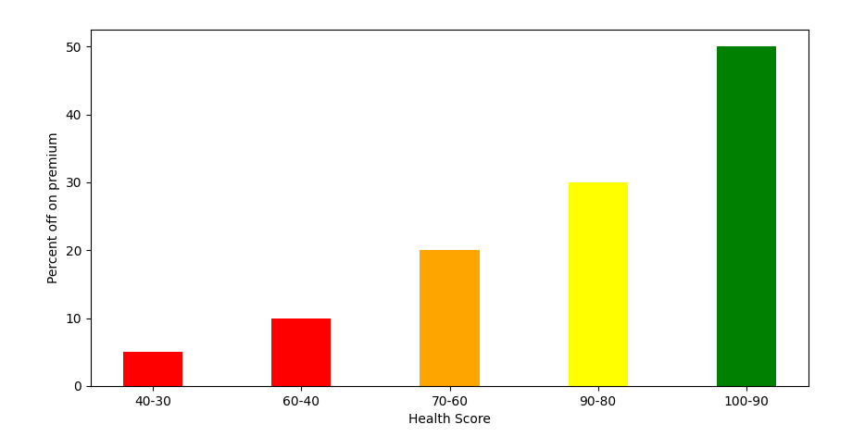
Chart rewards
Typical graph percentage rebate or excess you pay for your own health index.

Slide 13

Further plans apart from those executed till present
We have devised an algorithm to accurately measure health index using different components and criteria.
Website will form a database and keep it interactive for the user but tamperproof.
Form type of data will be automatically fed in the database and calculated per quarter.
We initially attempt to start from a website based portal and will slowly shift to application based portal.
We intend to develop a website which takes input mostly from automated devices like smart wearables and apps given by the company.
For demonstration purposes, website will be made live through GitHub pages which will later be given a proper domain.

Slide 14
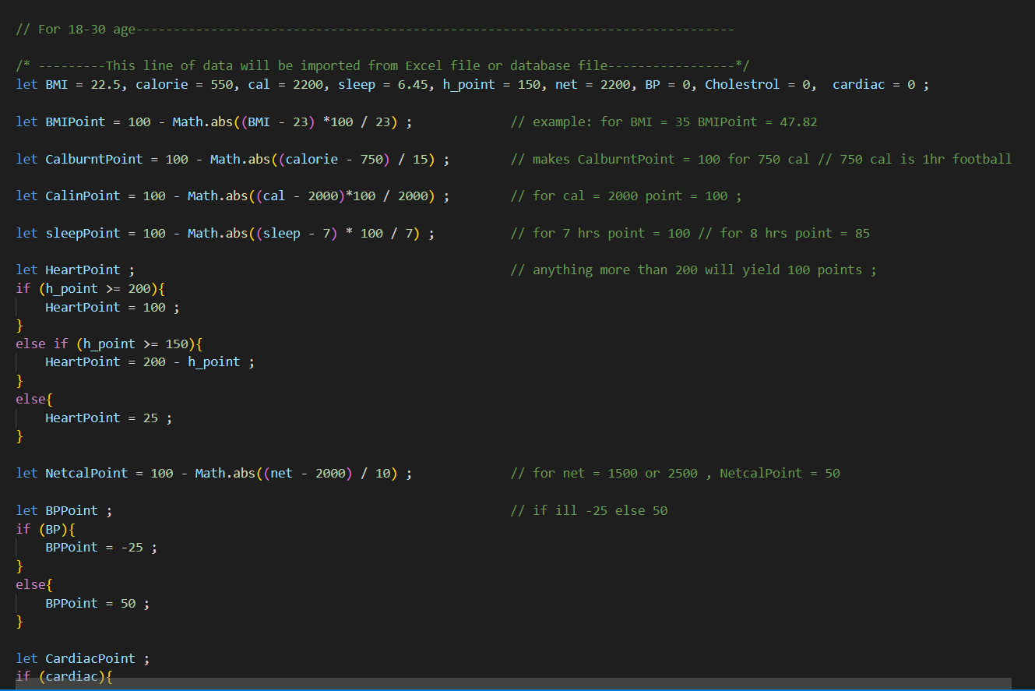

Slide 15
Systems we would like to use
Web development for a insurance product
Back-end
Front-end
Database
MS-Excel
Python
GitHub pages
C++ based linkups with smart wearables
HTML, CSS
JavaScript
Excel JS
React JS

Slide 16
Financials
Company or product can be based by solid financing and expectations.
The foremost revenue source will be the insurance premium and the gains made by investing those money.
All the members of policy will be encouraged to join gym or follow a class where the gym could generate revenue for the company.
Doctors will be appointed in the company office for regular check-up and available to all the policy holders.
There are still more stuff that can be potential revenue generators, discussions about which can be taken up when required.

Slide 17

THANK YOU!
Team Avengers
Krupal shah
Dakshveer Singh Chauhan
Harsh Patel

